Slide 1


ELK AI-Powered Error Detection in CI/CD
Proactive anomaly detection and intelligent response for DevOps pipelines. Minimize downtime with automated triage and remediation.
by CodeZero Zero

Slide 2






The 1:5:10 Advantage
1 Minute to Detect
Real-time anomaly identification
5 Minutes to Diagnose
AI-powered context analysis
10 Minutes to Fix
Automated remediation protocols

Slide 3





Core Architecture
Logstash
Collects and transforms log data from all pipeline stages.
Elasticsearch
Indexes data for lightning-fast analysis and querying.
Kibana
Visualizes patterns and anomalies for human oversight.
AI Layer
Applies machine learning to identify threats and automate responses.

Slide 4





Real-Time Detection
Log Generation
HTTP 401 error captured from application gateway.
Collection & Processing
Logstash enriches with metadata and forwards to Elasticsearch.
Pattern Analysis
AI examines source IP, user ID, and accessed endpoint.
Anomaly Flagging
System identifies potential unauthorized access attempts.

Slide 5








Intelligent Triage
Access Rights
Location Check
Check if user is authorized for the requested resource.
Evaluate if access comes from expected geographic location.
User Validation
Timing Analysis
Verify user exists and credentials are valid.
Assess if access attempt occurred during normal hours.

Slide 6





Automated Response
Alert Refinement
System adds context and severity level to notification.
User Notification
Affected end user receives detailed security email.
Team Alert
DevSecOps receives incident details via preferred channels.
Preventive Action
System temporarily restricts suspicious access patterns.

Slide 7

Measurable Outcomes
94%
78%
Detection Speed
Support Tickets
Faster than manual monitoring
Reduction in security-related tickets
87%
62%
MTTR
False Positives
Improvement in mean time to resolve
Reduction in false security alerts

Slide 8
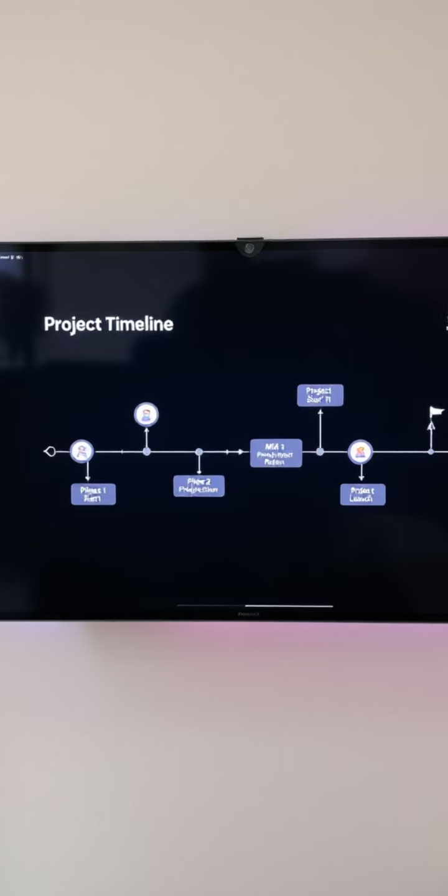
Implementation Roadmap
ELK Stack Integration
Connect logging infrastructure to your CI/CD pipeline. Establish baseline metrics.
AI Model Training
Train detection algorithms on your specific environment. Calibrate for your threat landscape.
Response Automation
Configure targeted remediation actions. Set up appropriate notification channels.
Continuous Refinement
Regularly tune detection thresholds. Update models with new threat patterns.

